Slide 1
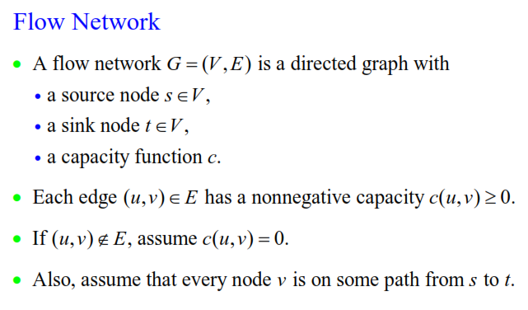
A Flow Network, terminology

Slide 2
A Flow Network, Constraints
Capacity constraint: Each edge has a maximum capacity ‘c_{e}’ allowed to transmit through such that.. Net flow cannot exceed c_{e}…
  ∀ u, v ∈ V: f(u, v) ≤ c(u, v)
Skew symmetry constraint:
  ∀ u, v ∈ V: f(u,v) = –f(v,u)
Flow conservation Law: The sum of the net flow incident to a vertex is equal to the net flow leaving the same vertex.
  If <u, v> ∉ E, then f(u, v)=0.
  What goes in = what leaves out: for all u ∈ V-{s,t}
  Σ_{v∈V}f(u, v) = Σ_{v∈V}f(v, u) =0,
  s and t vertices:
  Σ_{v∈V}f(v, s)=0, Σ_{v∈V}f(t, v)=0,
  Σ_{v∈V}f(s, v) = Σ_{v∈V}f(v, t)>0 and R+,

Slide 3
No leakage and no memory is allowed.
Total value of flow, |f| = f(s, V) = f(V, t)
Application Areas
Traffic, freight, airflow, communications, and stocks, current flow
The Maximum Flow Problem Definition: is to find a feasible flow through a single-source, single-sink flow network that is maximum.

Slide 4
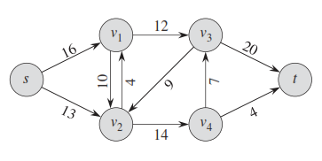
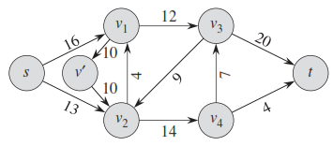
Opposite flows bt two vertices (due to skew symmetry) will cancel each other.
Find paths to maximize |f|.
f(X, Y) means Σx∈XΣy∈Yf(x, y)
f(u, V – {s, t}) = 0
Anti Parallel Edges:
  If an edge <u, v> and also <v, u> both are in the graph, they are called as antiparallel edges and if such antiparallel edges are present in the network then the network is transformed in to equivalent one containing no such antiparallel edges by introducing new dummy vertices

Slide 5
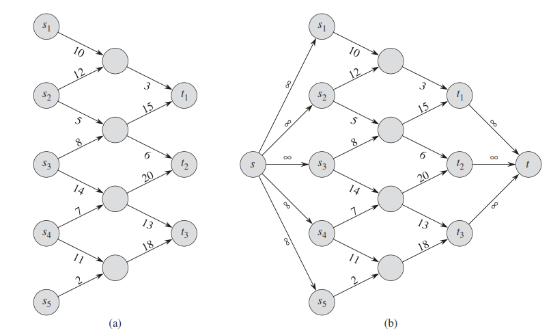
Networks with Multiple Sources and Multiple Sinks
Super source and super sink connected with infinite capacity

Slide 6
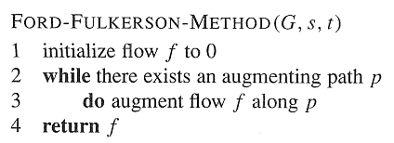
Ford-Fulkerson method
Initialize flow value to 0. Start to iterate
Find augmenting paths
  Find a path p from s to t, such that there is some flow value x > 0, and for each edge (u, v) in p, add x units of flow to |f|, such that
  max{x} ≤ min{c_{f}(u, v): (u, v) is on p}.
  Increment flow, f(u, v) = f(u, v) + x
Calculate residual capacities: c_{f}(u,v) = c(u,v) – x
    i.e. the actual capacity minus the net flow (x) from u to v
    Flow may be negative!! That can be interpreted as increasing residual capacity.
Residual network: G_{f} =(V, E_{f}), where
  E_{f} = {(u,v) ∈ V × V : c_{f}(u,v) > 0}
Continue till no any augmenting path (any forward channel) left through
Observation – edges in E_{f} are either edges in E or their reversals: |E_{f}| ≤ 2|E|
Augmenting Path?
13
a
b
19
15
10
9
5
t
s
4
14
11
3
c
d

Slide 7
Ford-Fulkerson method
Contains several algorithms:
  Residue networks
  Augmenting paths
    Find a path p from s to t (augmenting path), such that there is some value x > 0, and for each edge (u,v) in p we can add x units of flow
      f(u,v) + x ≤ c(u,v)
Augmenting Path?
a
8/13
b
10/15
13/19
s
10
9
5/5
t
2/4
6/14
c
8/11
d
3/3

Slide 8
Residual Network
To find augmenting path we can find any path in the residual network:
  Residual capacities: c_{f}(u,v) = c(u,v) – f(u,v)
    i.e. the actual capacity minus the net flow from u to v
    Net flow may be negative
  Residual network: G_{f} =(V,E_{f}), where
    E_{f} = {(u,v) ∈ V × V : c_{f}(u,v) > 0}

Slide 9
Residual Capacity and Augmenting Path
Finding an Augmenting Path
  Find a path from s to t in the residual graph
  The residual capacity of a path p in G_{f}:
  c_{f}(p) = min{c_{f}(u,v): (u,v) is in p}
    i.e. find the minimum capacity along p
  Doing augmentation: for all (u,v) in p, we just add this c_{f}(p) to f(u,v) (and subtract it from f(v,u))
  Resulting flow is a valid flow with a larger value.

Slide 10
The Ford-Fulkerson method
Ford-Fulkerson(G,s,t)
1 for each edge (u,v) in G.E do
2 f(u,v) ← f(v,u) ← 0
3 while there exists a path p from s to t in residual network G_{f} do
4 c_{f} = min{c_{f}(u,v): (u,v) is in p}
5 for each edge (u,v) in p do
6 f(u,v) ← f(u,v) + c_{f}
7 f(v,u) ← -f(u,v)
8 return f
The algorithms based on this method differ in how they choose p in step 3.
Steps 1, 2, O(E), and 4-7 O(E) times for each unit of |f*|.
If chosen poorly the algorithm might not terminate.

Slide 11
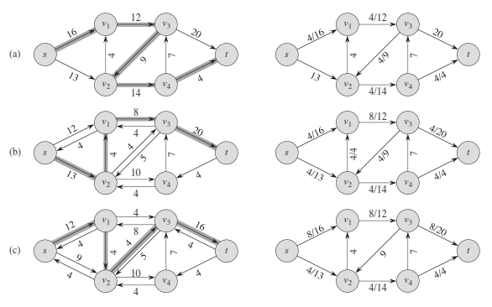
Execution of Ford-Fulkerson
Left Side = Residual Graph Right Side = Augmented Flow

Slide 12
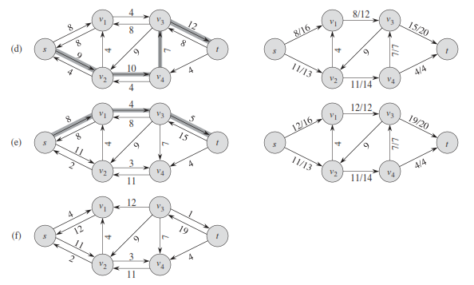
Execution of Ford-Fulkerson
Left Side = Residual Graph Right Side = Augmented Flow

Slide 13
Max. Flow - Min. Cut
A cut (S, T) of flow network G = (V, E) is a partition (or a disjoint set) of V into S and T = V - S such that s ∈ S and t ∈ T.
MST cut was for undirected graphs, here a directed graph is cut such that s ∈ S and t ∈ T.
If f is a flow, then the net flow across the cut (S, T) is defined to be â(S, T). The capacity of the cut (S, T) is c(S, T).
f(S, T) = Σu∈SΣv∈Tf(u, v) <= Σu∈SΣv∈Tc(u, v) = c(S, T).
The value of any flow â in a flow network G is bounded from above by the capacity of any cut of G.
Minimum cut – a cut with the smallest capacity of all cuts.
  |f|= f(S,T) i.e. the value of a max flow is equal to the capacity of a min cut.
f(S, T) = Σu∈SΣv∈Tf(u, v) = Σu∈SΣv∈Tc(u, v) = c(S, T).
The value of max. flow in a flow network G is equal to the capacity of min. cut of G.

Slide 14
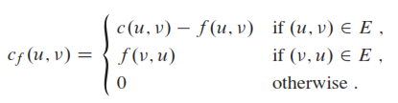
Let G = (V, E) be a flow network with source s and sink t.
Let f be a flow in G. For a pair of vertices u, v Ɛ V, the residual capacity c_{f}(u,v) is defined as
The residual network of G induced by f is G_{f} = (V, E_{f}) where E_{f} = { (u,v) Ɛ VxV : c_{f}(u,v) > 0}
If f is a flow in G and f’ is a flow in the corresponding residual network G_{f} then f + f’, the augmentation of flow f by f’ is defined as
(f+f’)(u,v) = f(u,v) + f’(u,v) – f’(v,u) if (u,v) Ɛ E
= 0 otherwise

Slide 15
Max-flow min-cut theorem
If f is a flow in a flow network G=(V, E) with source s and sink t, then the following conditions are equivalent:
1. f is a maximum flow in G.
2. The residual network Gf contains no augmenting paths.
3. Flow value of f = c(S, T) for some cut (S,T) of G. (This cut is called min-cut. Bottleneck. Among all the cuts of G(S, T), it is the cut that returns the minimum capacity.)

Slide 16
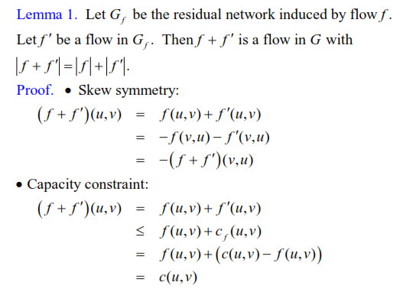

Slide 17
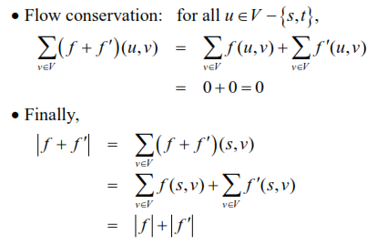

Slide 18
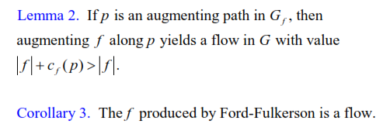

Slide 19
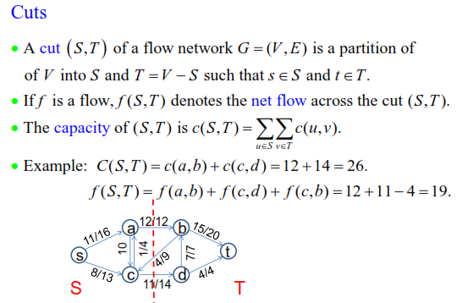

Slide 20


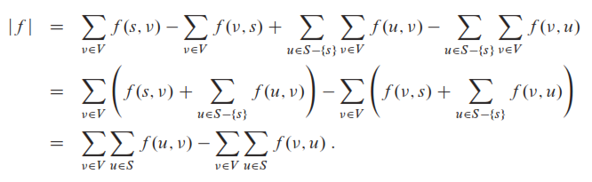
Lemma 4

Slide 21

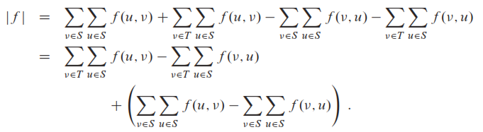
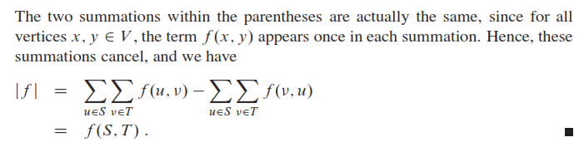

Slide 22
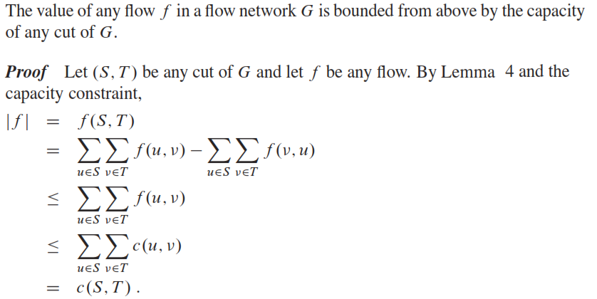
Lemma 5

Slide 23

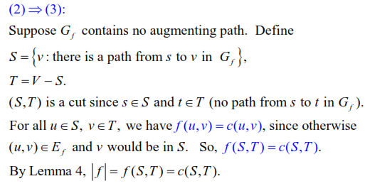
Proof

Slide 24
Worst case analysis
In the worst case, suppose that at each step Ford-Fulkerson’s algorithm performs some small incremental (integer) augmentations of ∆f, then the number of iterations to reach to the maximum flow, |f*|/∆f, where f* is maximum flow.
In the given example program starts to traverse through path π₁, s→u→v→t and alternates to the path π₂, s→v→u→t. instead of completing the algorithm in two steps.
The running time of Ford-Fulkerson’s algorithm is O(|f*|(E))
1000000
v
1000000
s
1/1
π₁
t
1000000
1000000
u
v
1/1000000-1
1000000
s
1
π₂
1000000-1/1
t
1000000
u
1000000-1/1
v
1000000-1/1
s
1
π₁
t
1/1000000-1
1/1000000-1
u

Slide 25
Edmonds-Karp algorithm
If searching path p in line 3, is implemented with a BFS in the residual network, and if the augmentation path is a shortest path from s to t, regardless of the weights of edges,
Edmonds-Karp algorithm. O(VE²), take shortest augmentation path.
Since the time required to find shortest augmenting path by breadth-first search is in O(n+m)=O(m) for networks represented by their adjacency lists, the time efficiency of the shortest-augmenting-path algorithm is in O(VE²) or O(nm²) for this representation.
Running time O(VE²), because the number of augmentations is O(VE)
Notes:
CHAPTER 11: NETWORK FLOWS

Slide 26
Application – Maximum Bipartite Matching
Finding an optimal matching of vertices in a Bipartite Graph

Slide 27
Bipartite Graph
A bipartite graph is an undirected graph G=(V,E) in which V can be partitioned into two sets V₁ and V₂ such that (u,v) ∈ E implies either u ∈ V₁ and v ∈ V₂ or vice versa.
That is, all edges go between the two sets V₁ and V₂ and not within V₁ and V₂.

Slide 28
Model for Matching Problem
A
A
X
X
A
X
B
B
B
Y
Y
Y
C
C
C
Z
Z
Z
D
D
D
A matching
Optimal matching

Slide 29
Solution Using Max Flow
Add a supersource, supersink, make each undirected edge directed with a flow of 1
A
A
X
X
B
B
t
Y
s
Y
C
C
Z
Z
D
D
Since the input is 1, flow conservation prevents multiple matchings

Slide 30
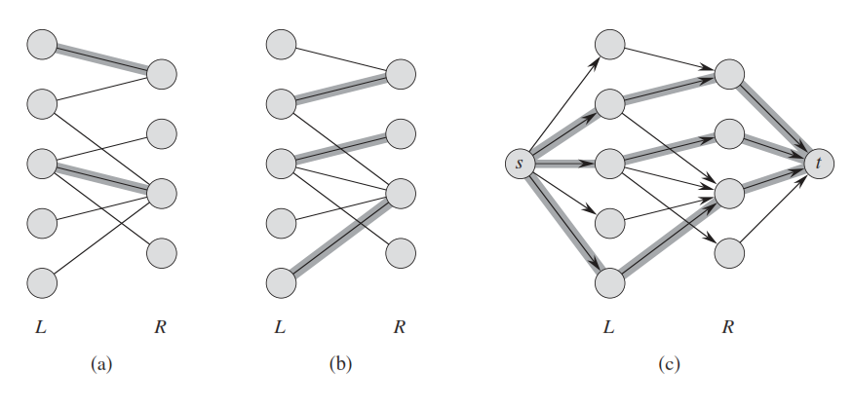
Example

Slide 31
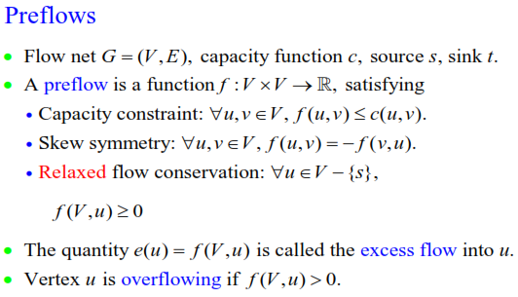
Push Relabel Algorithm

Slide 32
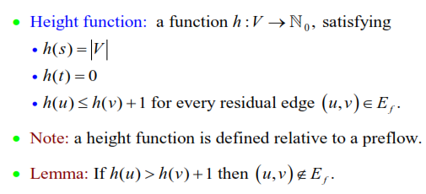

Slide 33
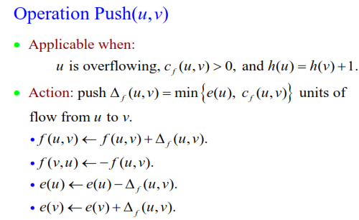

Slide 34
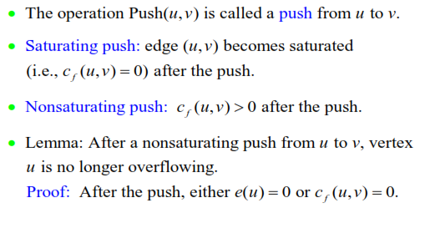

Slide 35
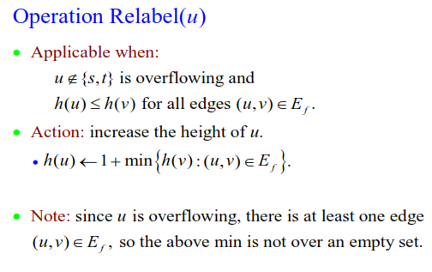

Slide 36
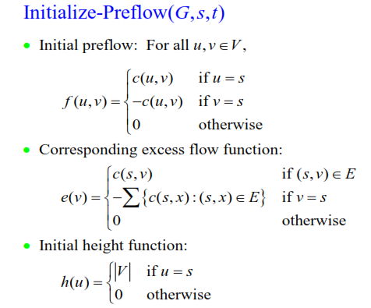

Slide 37
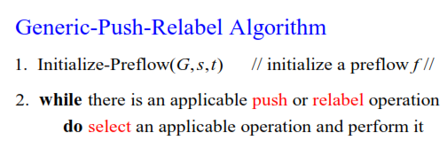

Slide 38
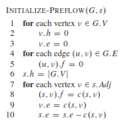

Slide 39
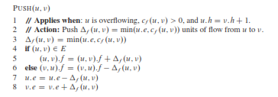

Slide 40


Slide 41
